Slide 1
Chapter 9 – Classification and Regression Trees
Data Mining for Business Analytics in R
Shmueli, Bruce, Yahav, Patel & Lichtendahl

Slide 2
Trees and Rules
Goal: Classify or predict an outcome based on a set of predictors
The output is a set of rules
Example:
Goal: classify a record as “will accept credit card offer” or “will not accept”
Rule might be “IF (Income >= 106) AND (Education < 1.5) AND (Family <= 2.5) THEN Class = 0 (nonacceptor)
Also called CART, Decision Trees, or just Trees
Rules are represented by tree diagrams

Slide 3
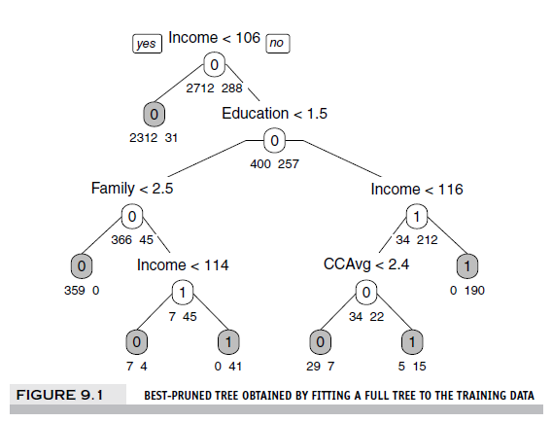

Slide 4
Key Ideas
Recursive partitioning: Repeatedly split the records into two parts so as to achieve maximum homogeneity of outcome within each new part
Pruning the tree: Simplify the tree by pruning peripheral branches to avoid overfitting

Slide 5
Recursive Partitioning

Slide 6
Recursive Partitioning Steps
Pick one of the predictor variables, x_{i}
Pick a value of x_{i,} say s_{i}, that divides the training data into two (not necessarily equal) portions
Measure how “pure” or homogeneous each of the resulting portions is
“Pure” = containing records of mostly one class (or, for prediction, records with similar outcome values)
Algorithm tries different values of x_{i,} and s_{i} to maximize purity in initial split
After you get a “maximum purity” split, repeat the process for a second split (on any variable), and so on

Slide 7
Example: Riding Mowers
Goal: Classify 24 households as owning or not owning riding mowers
Predictors = Income, Lot Size
library rpart for running trees, function prp in library rpart.plot to plot them

Slide 8
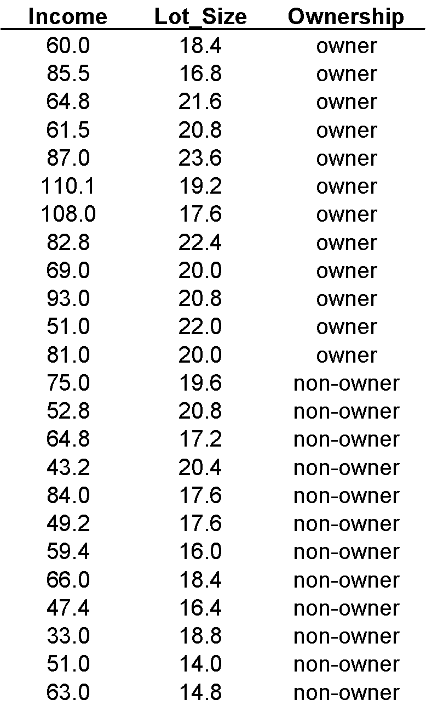

Slide 9
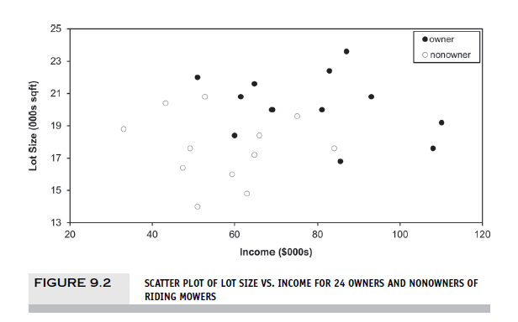

Slide 10
How to split
Order records according to one variable, say income
Take a predictor value, say 60 (the first record) and divide records into those with income >= 60 and those < 60
Measure resulting purity (homogeneity) of class in each resulting portion
Try all other split values
Repeat for other variable(s)
Select the one variable & split that yields the most purity

Slide 11
Note: Categorical Variables
Examine all possible ways in which the categories can be split.
E.g., categories A, B, C can be split 3 ways
{A} and {B, C}
{B} and {A, C}
{C} and {A, B}
With many categories, # of splits becomes huge

Slide 12
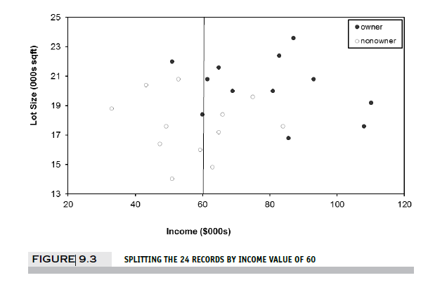
The first split: Income = 60

Slide 13
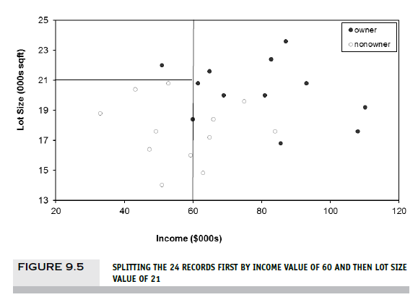
Second Split: Lot size = 21

Slide 14
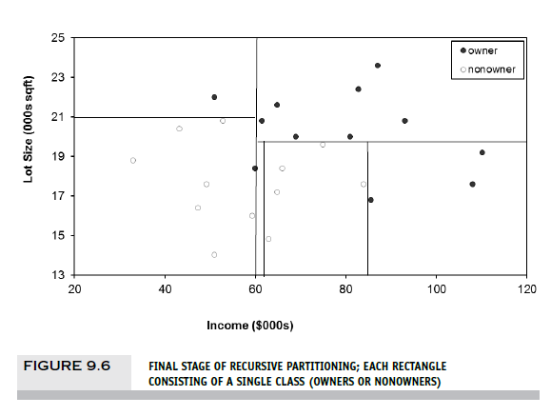
After All Splits

Slide 15
Measuring Impurity

Slide 16
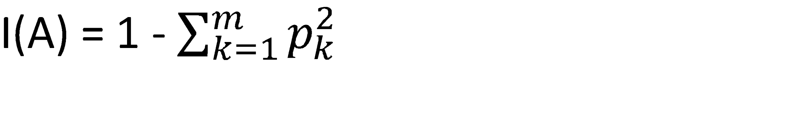
Gini Index
Gini Index for rectangle A
p = proportion of cases in rectangle A that belong to class k (out of m classes)
I(A) = 0 when all cases belong to same class
Max value when all classes are equally represented (= 0.50 in binary case)
Note: XLMiner uses a variant called “delta splitting rule”

Slide 17
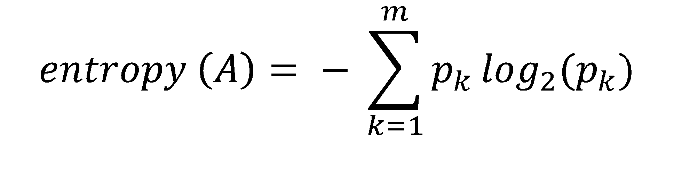
Entropy
p = proportion of cases in rectangle A that belong to class k (out of m classes)
Entropy ranges between 0 (most pure) and log₂(m) (equal representation of classes)

Slide 18
Impurity and Recursive Partitioning
Obtain overall impurity measure (weighted avg. of individual rectangles)
At each successive stage, compare this measure across all possible splits in all variables
Choose the split that reduces impurity the most
Chosen split points become nodes on the tree

Slide 19
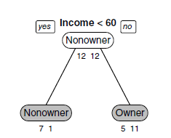
First Split – The Tree

Slide 20
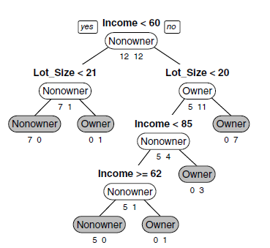
Tree after all splits
The first split is on Income, then the next split is on Lot Size for both the low income group (at lot size 21) and the high income split (at lot size 20)

Slide 21
Decision node
Terminal node (leaf)

Slide 22
The dominant class in this portion of the first split (those with income >= 60) is “owner” – 11 owners and 5 non-owners
The next split for this group of 16 will be on the basis of lot size, splitting at 20

Slide 23
Read down the tree to derive rules
If Income < 60 AND
Lot Size < 21,
classify as “Nonowner”

Slide 24
The Overfitting Problem

Slide 25
Full trees are complex and overfit the data
Natural end of process is 100% purity in each leaf
This overfits the data, which end up fitting noise in the data
Consider Example 2, Loan Acceptance with more records and more variables than the Riding Mower data – the full tree is very complex

Slide 26
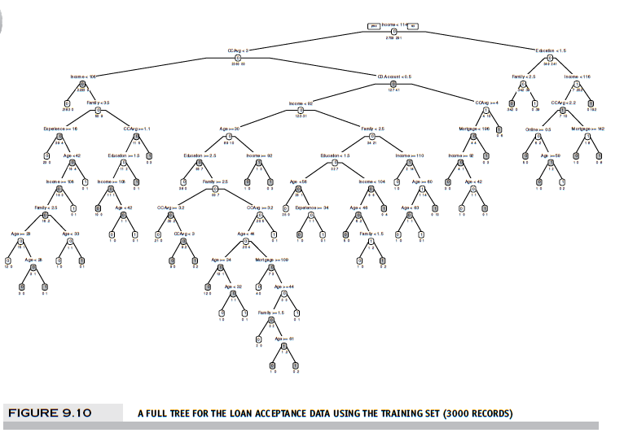
Full trees are too complex – they end up fitting noise, overfitting the data

Slide 27
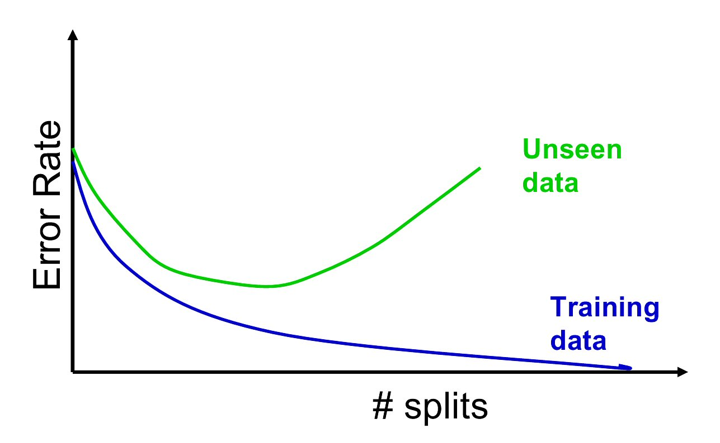
Overfitting produces poor predictive performance – past a certain point in tree complexity, the error rate on new data starts to increase

Slide 28
Stopping tree growth - CHAID
CHAID, older than CART, uses chi-square statistical test to limit tree growth
Splitting stops when purity improvement is not statistically significant

Slide 29

Pruning
CART lets tree grow to full extent, then prunes it back
Idea is to find that point at which the validation error is at a minimum
Generate successively smaller trees by pruning leaves
At each pruning stage, multiple trees are possible
Use cost complexity to choose the best tree at that stage

Slide 30
Which branch to cut at each stage of pruning?
CC(T) = Err(T) + α L(T)
CC(T) = cost complexity of a tree
Err(T) = proportion of misclassified records
α = penalty factor attached to tree size (set by user)
Among trees of given size, choose the one with lowest CC
Do this for each size of tree (stage of pruning)

Slide 31


Tree instability
If 2 or more variables are of roughly equal importance, which one CART chooses for the first split can depend on the initial partition into training and validation
A different partition into training/validation could lead to a different initial split
This can cascade down and produce a very different tree from the first training/validation partition
Solution is to try many different training/validation splits – “cross validation”

Slide 32
Cross validation
Do many different partitions (“folds*”) into training and validation, grow & pruned tree for each
Problem: We end up with lots of different pruned trees. Which one to choose?
Solution: Don’t choose a tree, choose a tree size:
For each iteration, record the cp that corresponds to the minimum validation error
Average these cp’s
With future data, grow tree to that optimum cp value
*typically folds are non-overlapping, i.e. data used in one validation fold will not be used in others

Slide 33
Cross validation, “best pruned”
In the above procedure, we select cp for minimum error tree
But… simpler is better: slightly smaller tree might do just as well
Solution: add a cushion to minimum error
Calculate standard error of cv estimate – this gives a rough range for chance variation
Add standard error to the actual error to allow for chance variation
Choose smallest tree within one std. error of minimum error
You can then use the corresponding cp to set cp for future data

Slide 34
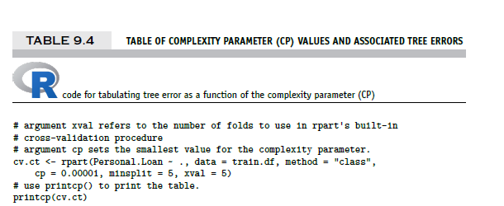
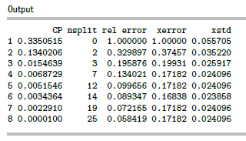
With future data, grow tree to 7 splits:
estimated cv error
std. error of the estimate
smallest tree within 1 xstd of min. error (it has 7 splits)
minimum error

Slide 35
Regression Trees

Slide 36
Regression Trees for Prediction
Used with continuous outcome variable
Procedure similar to classification tree
Many splits attempted, choose the one that minimizes impurity

Slide 37
Differences from CT
Prediction is computed as the average of numerical target variable in the rectangle (in CT it is majority vote)
Impurity measured by sum of squared deviations from leaf mean
Performance measured by RMSE (root mean squared error)

Slide 38
Advantages of trees
Easy to use, understand
Produce rules that are easy to interpret & implement
Variable selection & reduction is automatic
Do not require the assumptions of statistical models
Can work without extensive handling of missing data
Disadvantage of single trees: instability and poor predictive performance

Slide 39
Random Forests and Boosted Trees
Examples of “ensemble” methods, “Wisdom of the Crowd” (Chap 13)
Predictions from many trees are combined
Very good predictive performance, better than single trees (often the top choice for predictive modeling)
Cost: loss of rules you can explain implement (since you are dealing with many trees, not a single tree)
However, RF does produce “variable importance scores,” (using information about how predictors reduce Gini scores over all the trees in the forest)

Slide 40
Random Forests (library randomForest)
Draw multiple bootstrap resamples of cases from the data
For each resample, use a random subset of predictors and produce a tree
Combine the predictions/classifications from all the trees (the “forest”)
Voting for classification
Averaging for prediction

Slide 41
Boosted Trees (library adabag)
Boosting, like RF, is an ensemble method – but uses an iterative approach in which each successive tree focuses its attention on the misclassified trees from the prior tree.
Fit a single tree
Draw a bootstrap sample of records with higher selection probability for misclassified records
Fit a new tree to the bootstrap sample
Repeat steps 2 & 3 multiple times
Use weighted voting (classification) or averaging (prediction) with heavier weights for later trees

Slide 42
Summary
Classification and Regression Trees are an easily understandable and transparent method for predicting or classifying new records
A single tree is a graphical representation of a set of rules
Tree growth must be stopped to avoid overfitting of the training data – cross-validation helps you pick the right cp level to stop tree growth
Ensembles (random forests, boosting) improve predictive performance, but you lose interpretability and the rules embodied in a single tree

